Slide 1
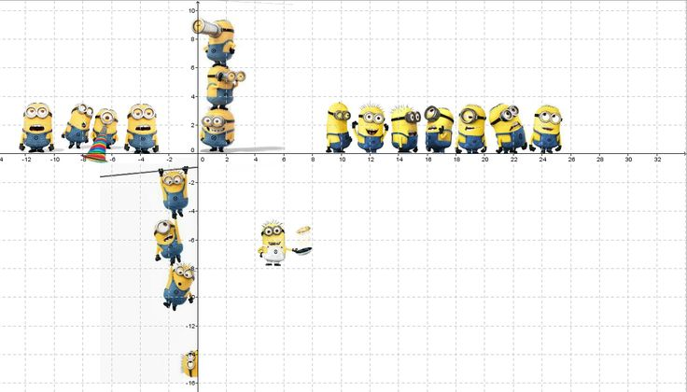
Number Interactive Notebook
Your Name
Class 8.4
Mrs Riksman
Term 1 Semester 1
1

Slide 2
Contents
Glossary
Page
Date
Description
Word
Description
4-5
5/2
Number Properties
Perfect Square
A whole number that is squared e.g 4 (2²)

Slide 3
Title:
Date:
Tasks
24
7
30
Essential Question
Questions
Notes
Summary
4
5

Slide 4
Title: Number Properties
Date: 5/2/15
24
7
30
EQ : Explain the meaning of multiples and factors
Question:
Notes:
A multiple of a number is obtained by multiplying the number by the counting numbers.
The Lowest Common Multiple (LCM) is the smallest multiple of two or more numbers that is common.
A factor of a number has a remainder of 0 when divided into the given number.
The Highest Common Factor (HCF) is the largest factor of two or more numbers that is common.
What is a multiple?
What is meant by LCM?
What is a factor?
What is meant by HCF?
5

Slide 5
Tasks
Write down the first 5 multiples of the following numbers
7 - 7,14,21,28,35
11 -
3 -
5 -
12 -
2. Find the lowest common multiples (LCM) of the following pairs of numbers:
3,4 - 3,6,9, 12,15,18, 4,8,12,16,20 LCM=12
8,12 -
5,9 -
2,3 -
12,20-

Slide 6
Tasks continued
3. Write the factors of the following numbers
20 1,2,5,10,20
32
48
77
64
4. Find the highest common factor (HCF) of these pairs of numbers
36, 48 36= 1,2,3,4,6,9,12,18,36
48= 1,2,3,4,6,8,12,16,24,48 HCF=12
7,13
6,8
16,24
19,31

Slide 7
Title: Number Properties
24
7
30
Date: 6/2/15
24
7
30
EQ : Describe prime and composite numbers
Define square and cube numbers and there roots
Question:
Notes:
Prime numbers have only two factors, the number itself and 1 e.g. 2,13
I is not considered to be a prime number
Composite numbers have more than two factors e.g.6, 20
The square of a number x is x² or x x x
If x is a whole number then x² is called a perfect square.
A square root of a number is written with the symbol √
√b = a if a²= b (and a is positive)
The cube of a number x is x³ = x x x x x
What are prime and composite numbers?
Describe a square number and give an example
7
5

Slide 8
Question:
Notes:
The cube of a number x is x³ = x x x x x
The cube root of a number is written with the symbol ³ √
³ √b = a if a³ = b
Describe a cube number and give an example
7

Slide 9
Tasks
Complete worksheet

Slide 10
Notes Review
24, 7 ,30
Date
Title
Essential question
Notes complete
Notes complete with colour and diagrams
Questions completed
Contents page filed in
Formula page filled in

Slide 11
Homework
Review your notes and write a summary answering the essential question.

